Slide 1
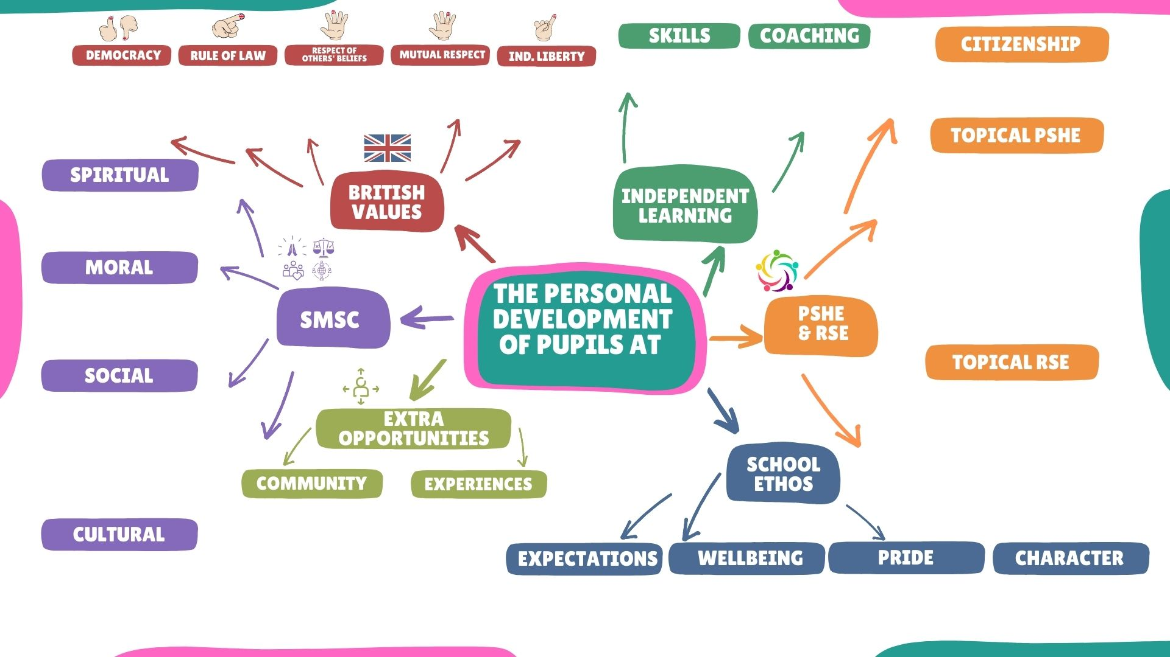
SEN/PP
ABLE/GD
School Council elections
Parliament Week
Assemblies
Restore, Respect, Reform
Magistrates
Police visitors
Rules
School Values
R.E
PSHE
Assemblies
History, Geography, PSHE, ART, RE & Assemblies
Assemblies
Bystander PSHE
Clubs
School Council
Adaptation
Technology
Pupil Passports
Learning Plans
Maths, Art, Computing clubs
Deepening challenges in class
Ambassadors
Active citizen- raising awareness, fundraising, volunteering and campaigning.
Relationships-Family, friendships, communication in friendships, diversity, celebrating differences, prejudice, racism.
Health and Wellbeing –Keeping healthy, habits, online safety, road safety , water safety, drugs, alcohol, teeth, diet, Clever Never Goes.
Living in the wider world
Jobs, Natwest money sense workshops, community, visitors, speakers.
RE-Big questions Kent syllabus
Christmas and Easter Church Services
Visits and speakers
School values
Behaviour Ladder
Restorative approach (consequences)
Eco-Council
Coxheath Primary School
Online safety
Change during puberty
Conception (Science)
Healthy bodies
Healthy minds
Mental health
Stereotypes
Racism
Hurtful behaviour
FGM Awareness
School council articles/policies
United against bullying participation
Children’s Mental health week
Restorative approach (resolving conflict )
Purple Card system
Nurture bus
Nurture provision, breakfast and ASC club
ELSA
School Values
Young voices choir
Choir to care homes
Food bank
Local charity
Gobal charities
School council
Eco council
Girls and Boys Football teams, Netball team, theatre trips, swimming, educational trips, educational visitors, assemblies with guests.
Ambition Self-Belief Perseverance Independence Respect Excellence
School Value Tag weekly assembly, behaviour policy, Learner of the week assembly, behaviour ladder, reading awards, multiplication awards
Music curriculum
Singing assemblies
Assemblies
R.E
PSHE

