Slide 1
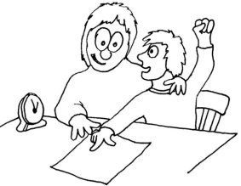

Precision Teaching
Coxheath Primary School
22/3/19

Slide 2
What is Precision Teaching?
A simple but intense, precise way of developing and measuring progress in a specific skill (e.g. single word reading, HFWs, phonics, times-tables, number bonds)
Suited to any child in any year group in any domain
Founded on the principle that mastery of a skill involves fluency and not just accuracy

Slide 3

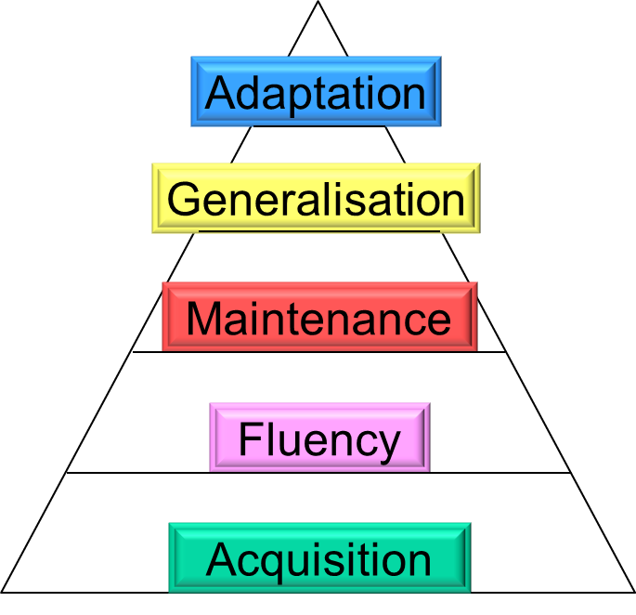
The Learning Hierarchy
Precision Teaching embeds fluency. If a child is fluent, they can move up the hierarchy.
Ultimate aim is that the child applies the skill.

Slide 4


Helping a child create well trodden paths…
Automaticity and brain capacity
Long-term memory retrieval requires revisiting the neural pathways the brain formed when it was initially taught or exposed to new learning. The strength of those pathways determines how quickly you recall and use the memory. To reinforce that initial memory, it must move multiple times across the nerve cells, retracing its step.
- Chiesa & Robertson, 2000

Slide 5
So, how do I do it?
<8m
1m
1m
Teach
Test
Record
Feedback
Little and often is key to success.

Slide 6
Step 1: Teach
Select the next step that the child needs to learn (times tables/phonemes/HFWs/number bonds). Teach what you intend to test (5 items)
Motivating games and activities for up to 8 mins (give plenty of encouragement):
- Bingo
- Word or number splat
  - Cloze procedure
  - Spot the adult’s mistake

Slide 7
Step 2: Test
Design test sheet so that it is appropriate to the teaching input
Test for 1 minute, setting a stopwatch or sandtimer
Record both correct and incorrect responses
If child gets stuck on an item, give them 4-5 mins to think, then move them along
Praise child!

Slide 8
Probe Sheets
Probe Type | Good for:-
See and Say | Letter recognition Number recognition Reading HFWs Identifying colours
Hear and Write | Identifying numbers Learning spellings
Hear and Say | Blending Segmenting
See and Write | Write answers to mathematical questions Forming letters Forming numbers
Have dozens of blank probe sheets ready. You will create a new probe with every new/amended set of items to test

Slide 9
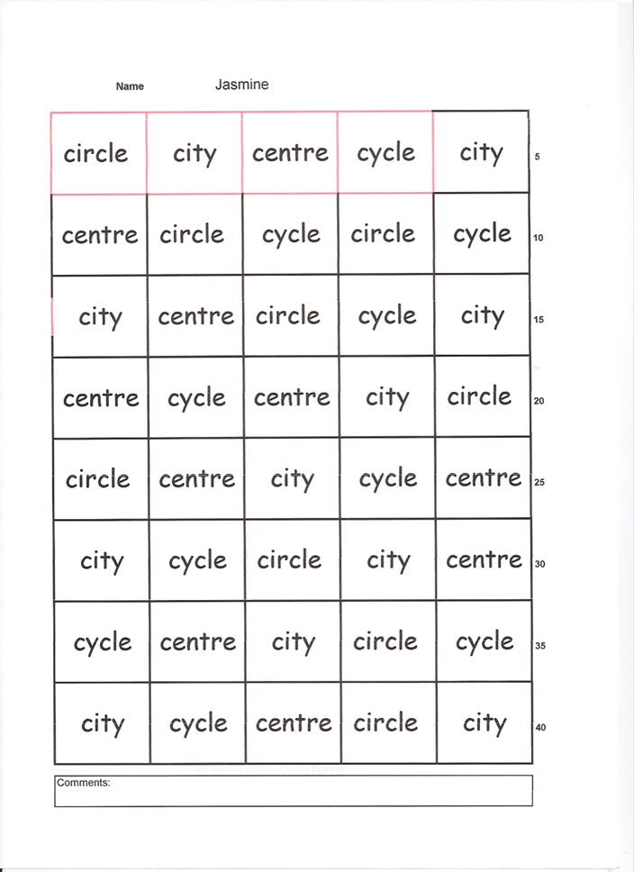
Features of test sheet:
Need to be a sufficient number of items on the test sheet to continue responding for one minute (Fill it up!)
5 items repeated
Important to place items in a randomised order
Test sheets to be re-usable; the same sheet to last a few days

Slide 10
Step 3: Record (i)
You record the child’s progress on the ‘Precision Teaching Graph’
Plot the number of incorrect responses on the bottom half of the chart (using crosses). This will show the child’s accuracy is improving.
Plot the number of correct responses on the top half of the chart (using dots). This will show how the child’s fluency is improving.

Slide 11
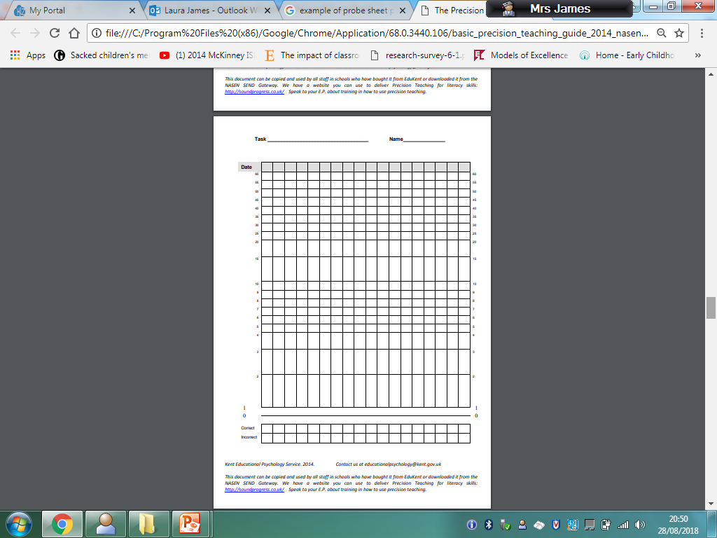
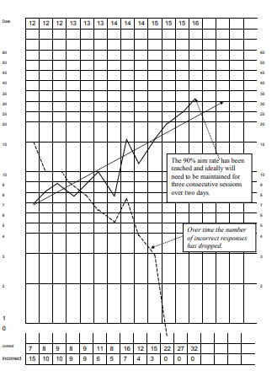

Slide 12
Step 3: Record (ii)
The chart will show the rate of learning.
When the fluency line starts to flatten out (a real learning curve!) this indicates the child is mastering the skill. It is time to move on.
Do not join points across weekends or missed days
Look at the chart – why does it have uneven jumps or numbers?
Share the chart with the child! It motivates them by demonstrating their success .

Slide 13
What if a child is stuck?
SLICE the task, e.g. reduce the words tested from 5 to 3.
And/Or
Adapt your teaching method, experiment. See what the child responds best to, e.g. more visual methods.

Slide 14
Further information/Free Resources
http://johnandgwyn.co.uk/probe.html
https://sites.google.com/site/eptoolbox/precision-teaching
https://www.sendgateway.org.uk/download.a-basic-guide-to-precision-teaching.html

